Slide 1

Introduction to Data Science
Machine Learning & Artificial
Intelligence
Advanced Algorithms, Statistical
Methods & Artificial Intelligence
Woodside Energy – Powered by AI
Webster 256
Wed 10-11
DAIL
Webster 256
Wed 11-12
Tyree G17
Fri 3-4

Slide 2
UNSW Data Science Society
Artificial Intelligence Lab
Introduction to Data Science
Machine Learning & Artificial
Intelligence
DAIL01
Daniel Han-Chen (Main Speaker)
Ben Smith (Speaker/Tutor)
Johnny Wong (Speaker/Tutor)
Nigel Lin (Tutor)
Anant Mathur (Tutor)
Christopher Shi (Tutor)
Nicholai Rank (Camera Person)

Slide 3
Disclaimer + Legal Stuff
All content in these courses are for educational purposes only. UNSW’s Mathematics and Statistics School and any UNSW entity including the Data Science Society and ARC is not responsible for any misuse or usage of our material in any commercial or educational practice and endeavor. Any UNSW entity and the society will not be in any way responsible for any damages caused if you are attending or watching these lectures online / or in person.
2. We thank UNSW’s Mathematics and Statistics School for allowing us to provide these lectures free of charge to all students.
3. NO RECORDINGS allowed. Strict rules. Only the society can record any material. All material will be placed on YouTube. If you want to record, please ask us first for permission. If we say yes, you must note the original owners of these lessons.
4. We’ll try our best to acknowledge all work and materials that we use within our presentation. If we forgot about some, we’re terribly sorry. Please contact us, and we’ll place an acknowledgement to the original author.
UNSW Data Science Society
Artificial Intelligence Lab

Slide 4
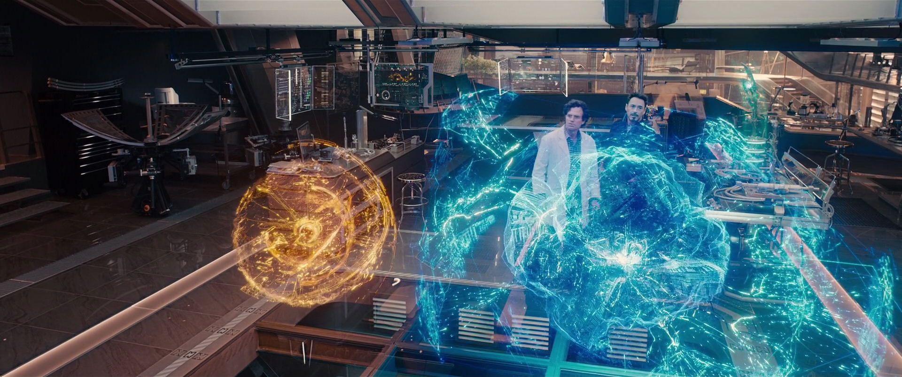
Artificial General Intelligence
& “Artificial” Intelligence
UNSW Data Science Society
Artificial Intelligence Lab

Slide 5
Machine Learning
What is Artificial Intelligence?
Computer Vision
Natural Language Processing
Tabular
Data
Robotics
Supervised Learning
Deep Learning
Data Science
Artificial Intelligence (Pattern Recognition)
Reinforcement Learning
Unsupervised Learning
Artificial Intelligence (Pattern Recognition)
Statistical
Algorithms
Machine Learning
Statistical Algos
Knowledge Representation
Networked Systems
Stochastic Modelling
Statistical
Methods
UNSW Data Science Society
Artificial Intelligence Lab

Slide 6
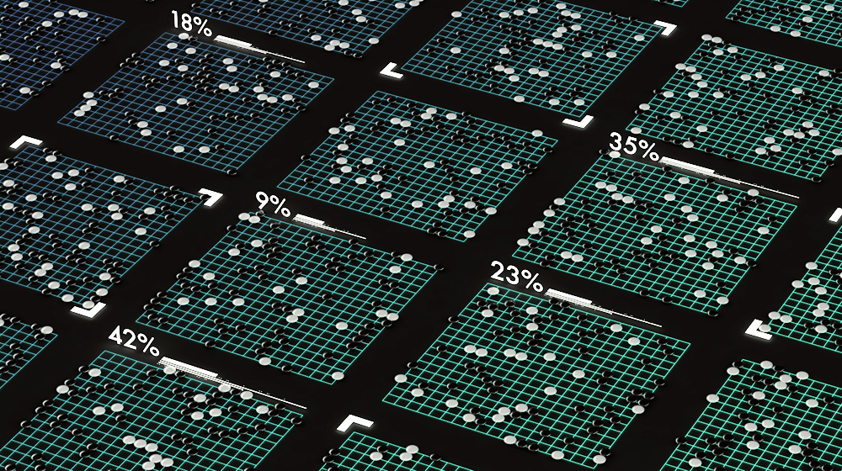

Current Artificial Intelligence Systems
UNSW Data Science Society
Artificial Intelligence Lab

Slide 7
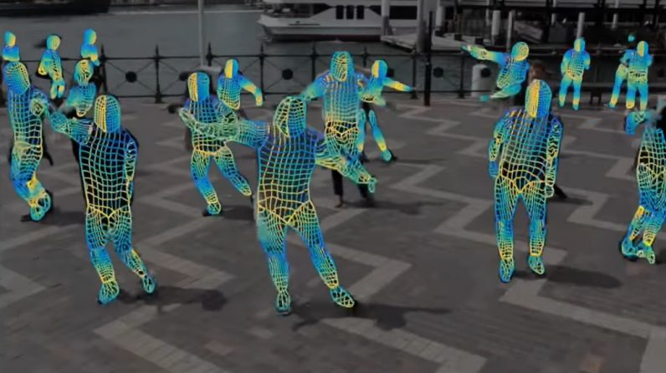

Current Artificial Intelligence Systems
UNSW Data Science Society
Artificial Intelligence Lab

Slide 8
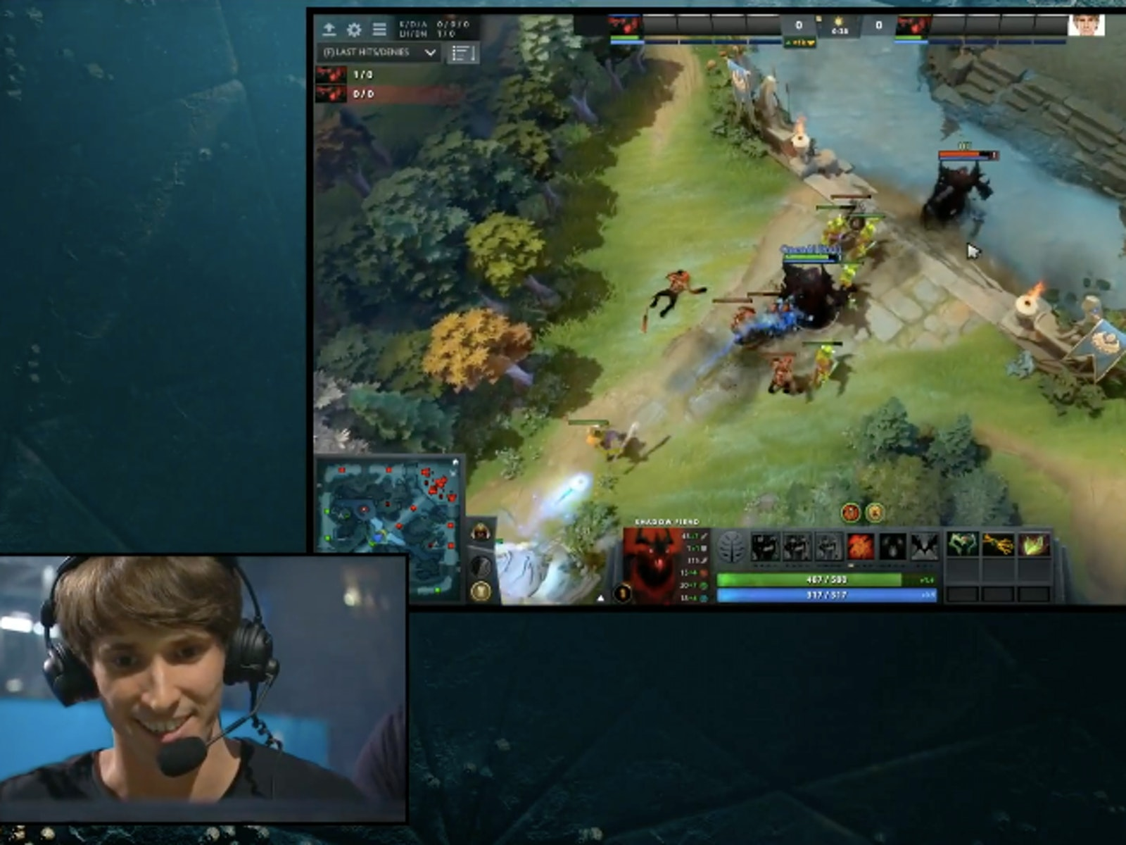
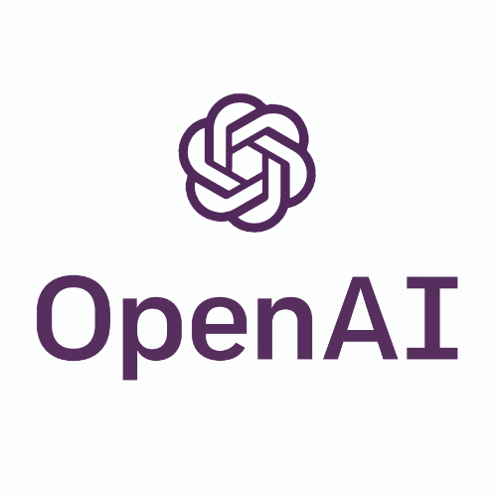
Current Artificial Intelligence Systems
UNSW Data Science Society
Artificial Intelligence Lab

Slide 9
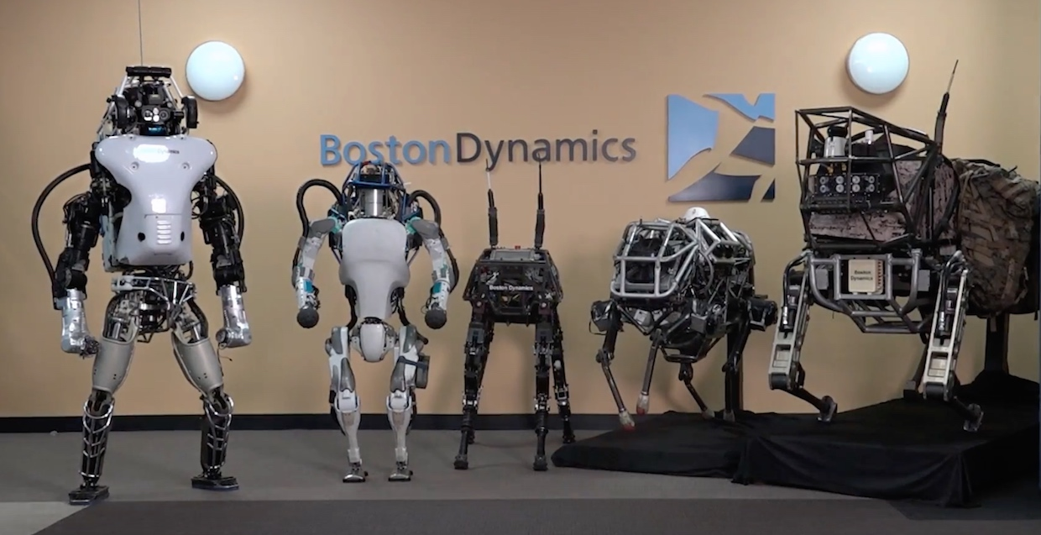

Current Artificial Intelligence Systems
UNSW Data Science Society
Artificial Intelligence Lab

Slide 10
Machine Learning
Introduction to DS, ML & AI
Tabular
Data
Supervised Learning
Deep Learning
Data Science
Artificial Intelligence (Pattern Recognition)
Artificial Intelligence (Pattern Recognition)
Statistical
Algorithms
Machine Learning
Statistical Algos
Statistical
Methods
UNSW Data Science Society
Artificial Intelligence Lab

Slide 11
Advanced Algorithms & AI
Machine Learning
Computer Vision
Natural Language Processing
Tabular
Data
Supervised Learning
Deep Learning
Data Science
Artificial Intelligence (Pattern Recognition)
Unsupervised Learning
Artificial Intelligence (Pattern Recognition)
Statistical
Algorithms
Machine Learning
Statistical Algos
Networked Systems
Stochastic Modelling
Statistical
Methods
UNSW Data Science Society
Artificial Intelligence Lab

Slide 12


Big AI Players
UNSW Data Science Society
Artificial Intelligence Lab

Slide 13
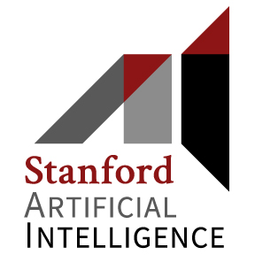


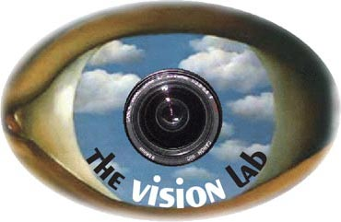
AI Labs and Academic Teams
UNSW Data Science Society
Artificial Intelligence Lab

Slide 14







Mathematical Foundations
$$\hat{θ}={\left(X^{T}X\right)}^{−1}X^{T}y$$
$$\hat{y}=a(a\left(Xθ_{1}+b_{1}\right)θ_{2}+b_{2})$$
$$M=UΣV^{∗}$$
$C=\frac{1}{2}{\left(\hat{y}−y\right)}^{T}$ $\left(\hat{y}−y\right)$
$$\hat{θ} ←\hat{θ}−λ∇C$$
$$P_{θ+1}={T^{θ}P}_{θ}$$
$$P(x|y)=\frac{P\left(y | x\right)P(x)}{P(y)}$$
UNSW Data Science Society
Artificial Intelligence Lab

Slide 15
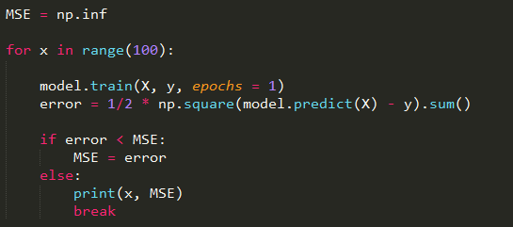
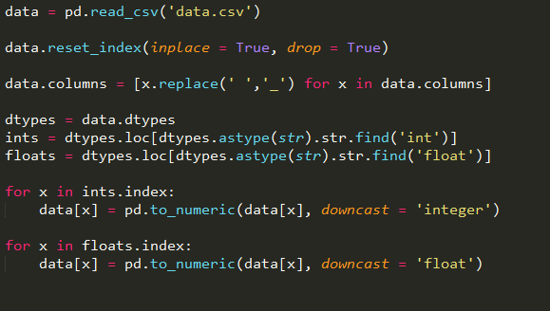
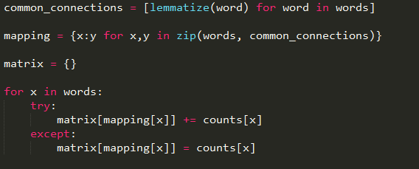
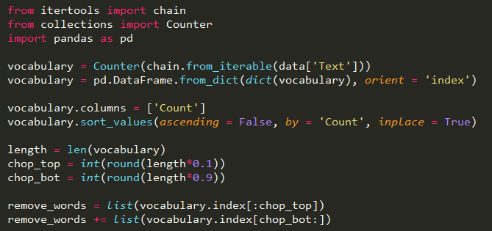
Programming Foundations
UNSW Data Science Society
Artificial Intelligence Lab

Slide 16
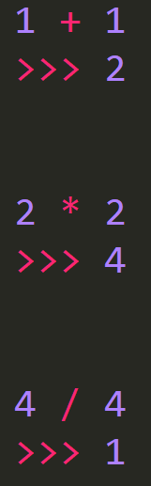
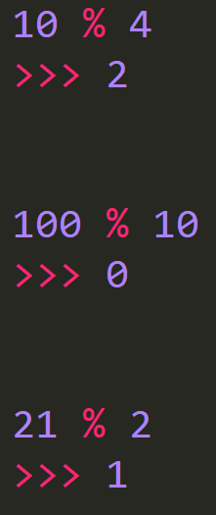
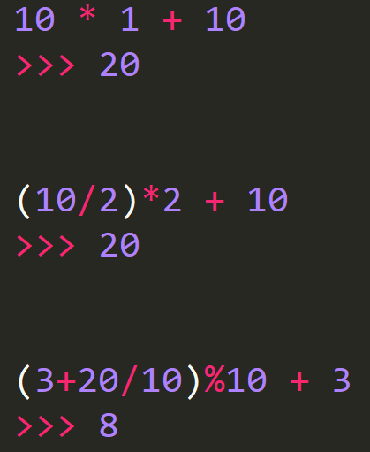
Programming Foundations
UNSW Data Science Society
Artificial Intelligence Lab

Slide 17
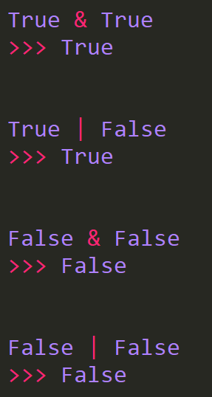
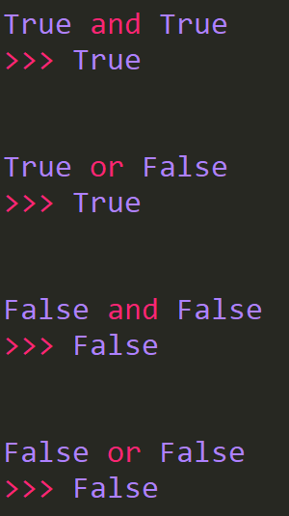
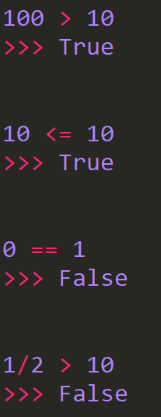
Programming Foundations
UNSW Data Science Society
Artificial Intelligence Lab

Slide 18
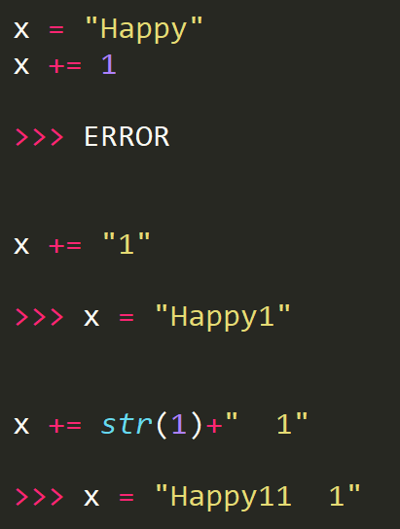
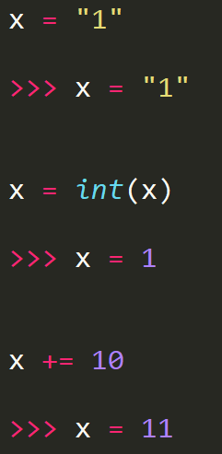
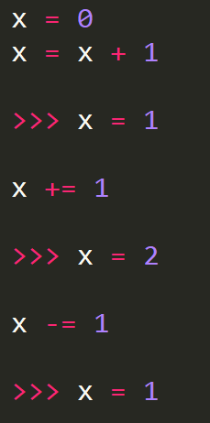
Programming Foundations
UNSW Data Science Society
Artificial Intelligence Lab

Slide 19
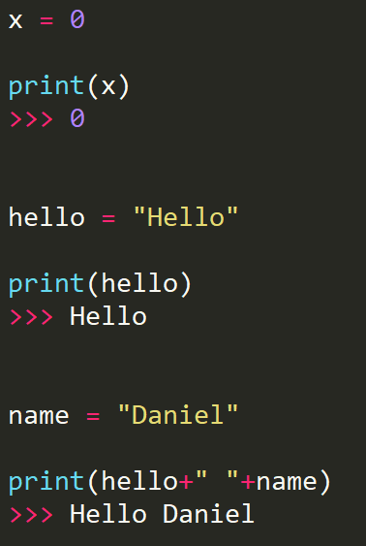
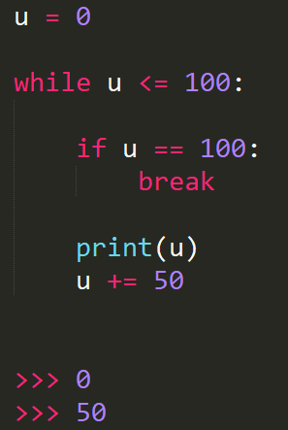
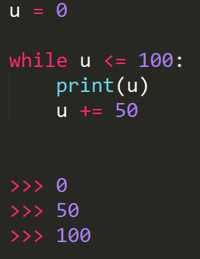
Programming Foundations
UNSW Data Science Society
Artificial Intelligence Lab

Slide 20
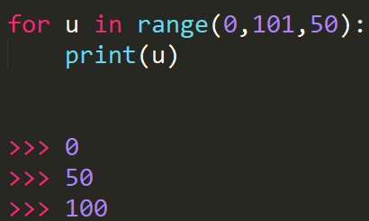
Programming Foundations
UNSW Data Science Society
Artificial Intelligence Lab

Slide 21
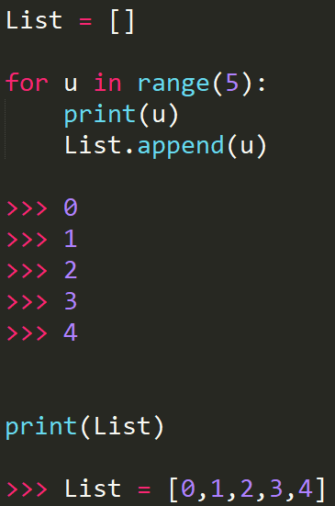
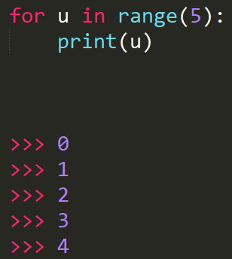
Programming Foundations
UNSW Data Science Society
Artificial Intelligence Lab

Slide 22
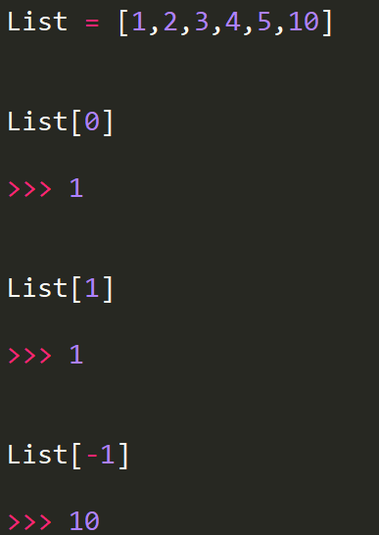
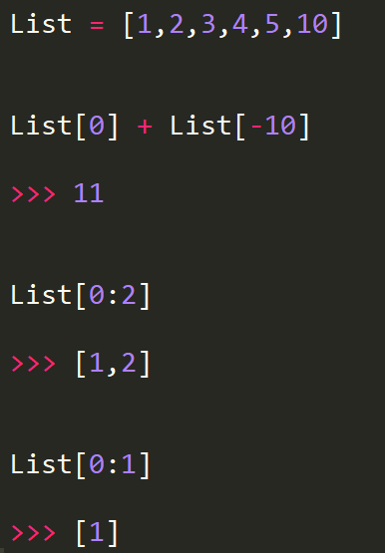
Programming Foundations
UNSW Data Science Society
Artificial Intelligence Lab

Slide 23
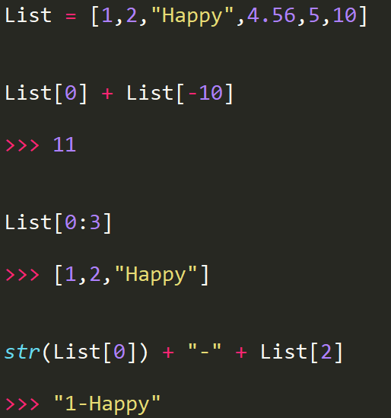
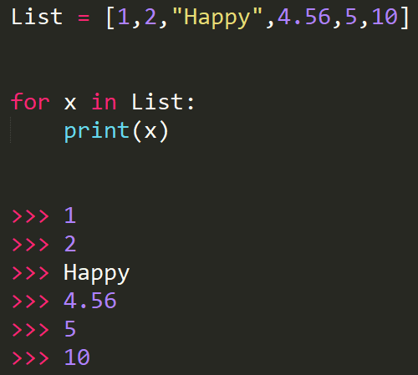
Programming Foundations
UNSW Data Science Society
Artificial Intelligence Lab

Slide 24
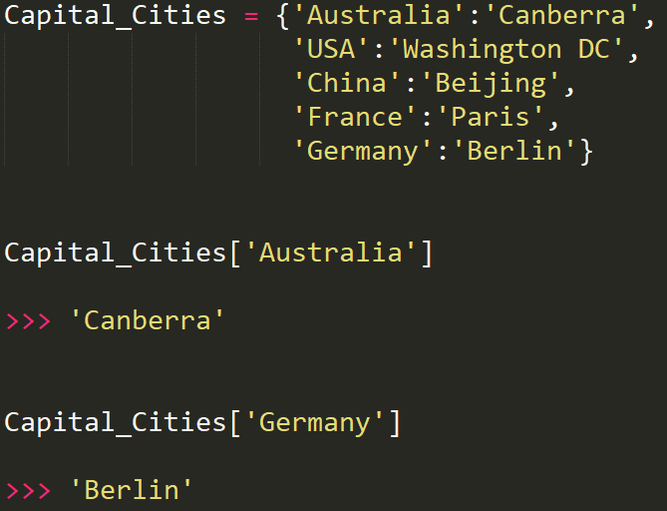
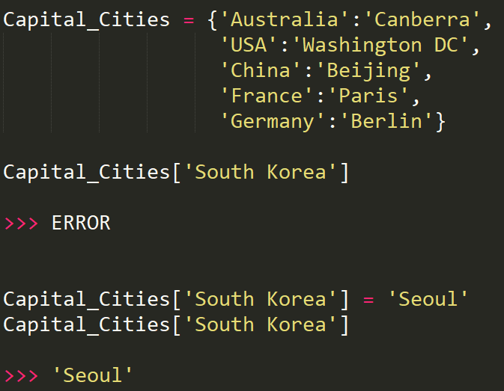
Programming Foundations
UNSW Data Science Society
Artificial Intelligence Lab

Slide 25
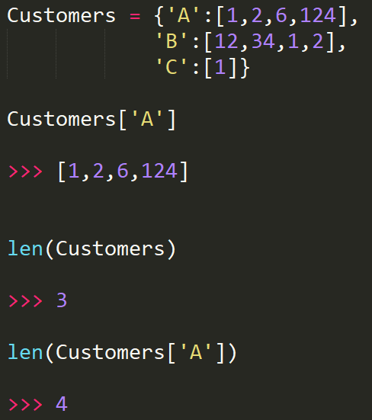
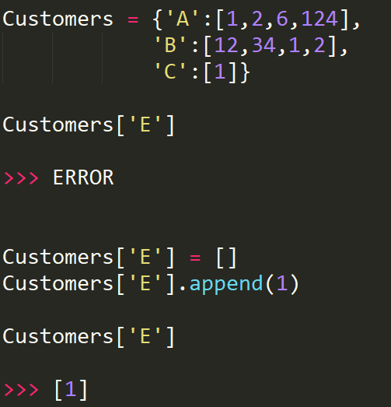
Programming Foundations
UNSW Data Science Society
Artificial Intelligence Lab

Slide 26
Acknowledgements
https://www.quantamagazine.org/best-ever-algorithm-found-for-huge-streams-of-data-20171024/
http://marvelcinematicuniverse.wikia.com/wiki/File:Jarvis_Ultron_Systems.jpg
https://deepmind.com/research/alphago/
https://www.quantamagazine.org/is-alphago-really-such-a-big-deal-20160329/
http://densepose.org/
https://openai.com/
https://www.bostondynamics.com/
UNSW Data Science Society
Artificial Intelligence Lab

